Slide 1


Hotel Booking Cancellations
Presented by: Thuy LE

Slide 2
ABOUT DATA
EXPLORATION
Approaching data and expected output
EDA and visualizing data
AGENDA
ANALYSING
CONCLUSION
Data pre-processing, modeling and model selection
Evaluation and recommendations

Slide 3

About Data And Approach
Data
Project aims to
Data is about two hotels : Resort and City Hotel. The structure of the dataset is with 32 variables describing 119390 observations. Each observation represents a hotel or resort booking. Both datasets comprehend bookings due to arrive between the 1st July 2015 and 31st August 2017, including arrived and canceled bookings.
To understand and analyze bookings cancellations, important features ;
Development of prediction models to classify a hotel booking's likelihood to be canceled or not
How the model will help the hotel?

Slide 4
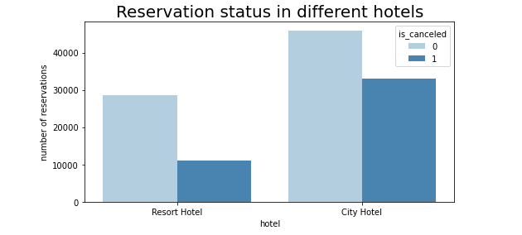
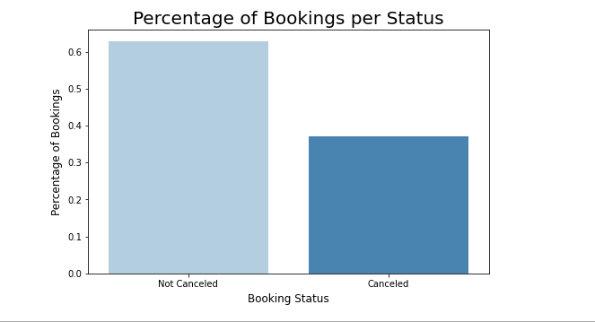
EXPLORATION
There are more booking from the city hotel than from the resort.
37% of bookings canceled

Slide 5
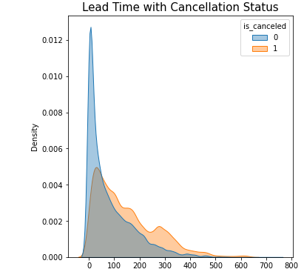
Lead Time
Days between booking and arrival
The longer lead time the higher cancellation rate
More time for unexpected events

Slide 6
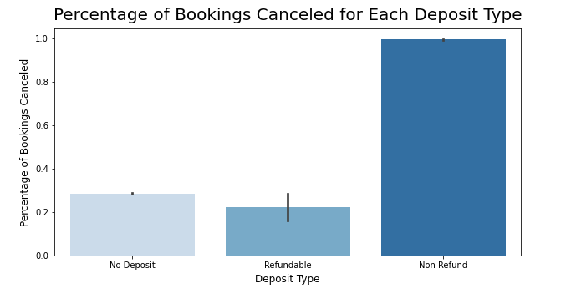
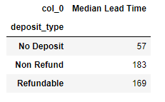
Deposit Type
Non-refundable deposit type has the highest percentage of canceled reservations.
From the table Non Refund Booking Has the highest median lead time. This might be the reason why non refund has the highest cancellation because of the longer lead time

Slide 7
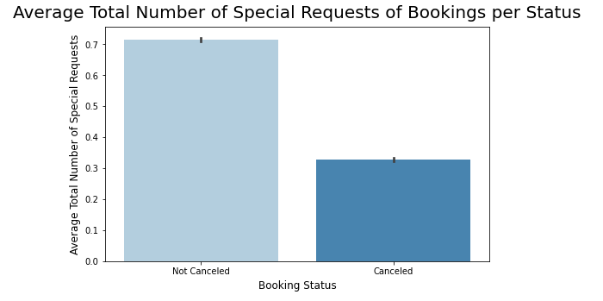
Special Request
The numbers of special request has a negative correlation with cancellation. The higher number of special request, the lower cancellation rate.
Communication between customer and hotel.

Slide 8
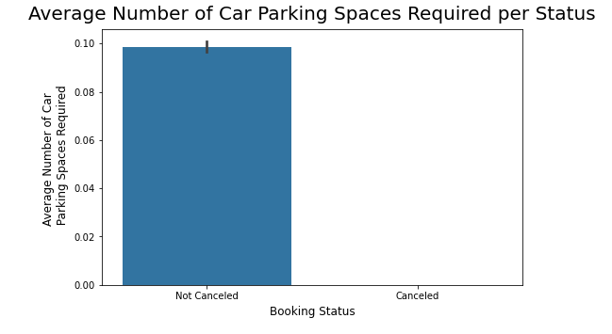
Parking Spaces
100% bookings with car parking spaces required showed up.
Limit option for customer.
Good insight in term of marketing

Slide 9
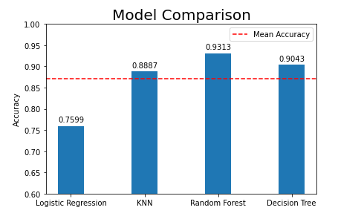
Analyzing / Methodology
After evaluation, the best three base models in terms of Accuracy were Random Forest, Decision Tree and KNN with 93%, 90% and 89% respectively.

Slide 10
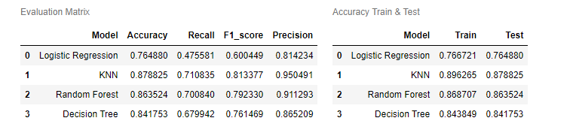
Hyperparameters And Results
Logistic Regression: penalty ‘l2’ and C = 0,1
KNN: n_neighbors=10.
Random Forest: n_estimators=500, max_depth=10
Decision Tree: max_depth=10

Slide 11
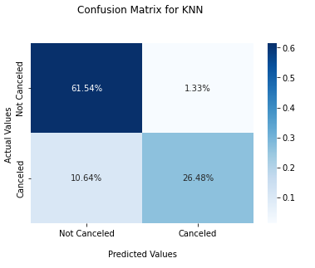
KNN Evaluation: Confusion Matrix
1,33% of cases: hotel may not be ready for guest, risk of overbooking.
10,64% of cases: hotel allocating their resources on the wrong reservations

Slide 12
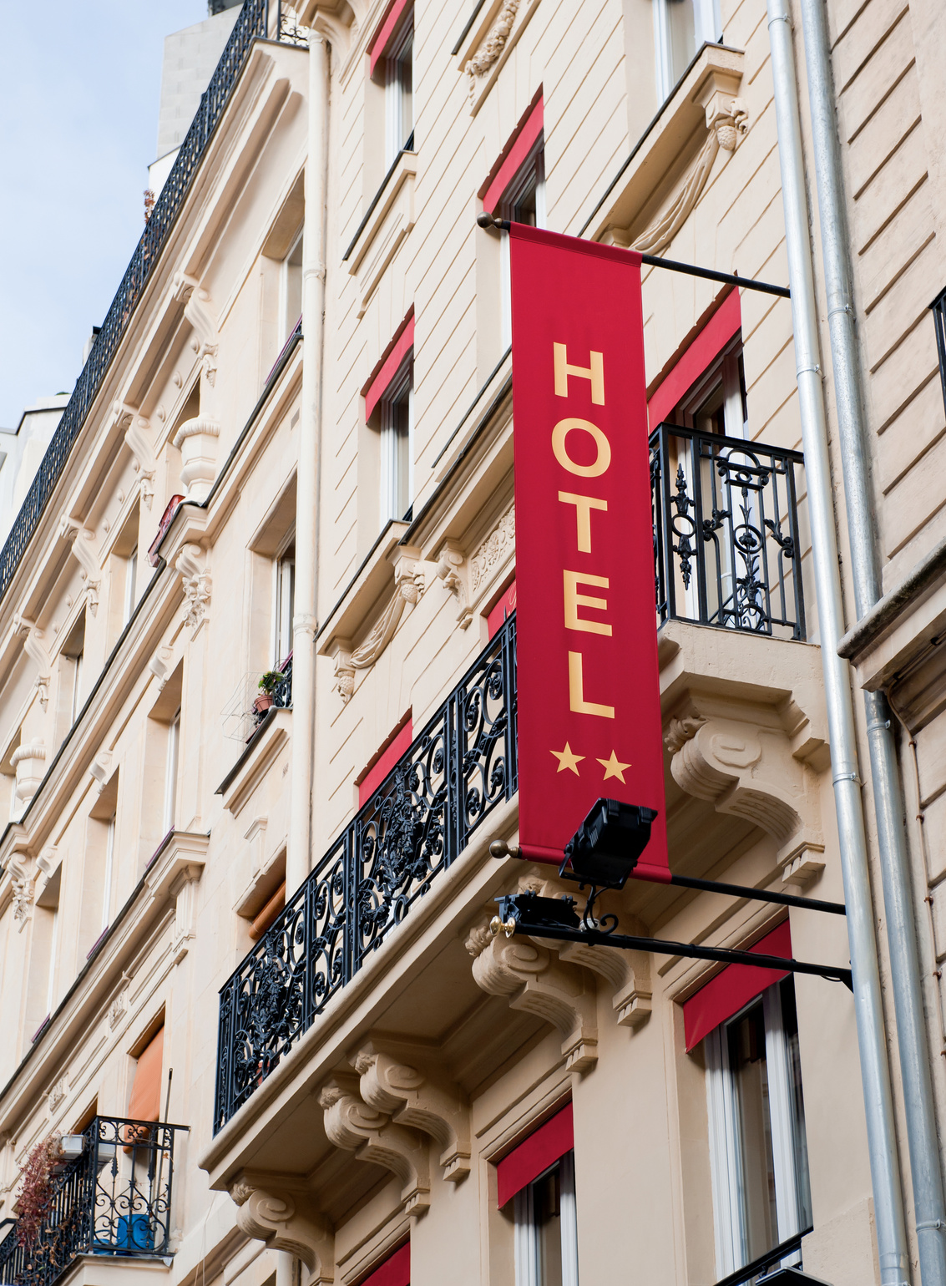
Conclusion
Algorithm which best predicted the cancellation is Kneighbors Classifier with 88% accuracy and high recall score.
1,33% of cases: hotel may not be ready for guest, risk of overbooking.
10,64% of cases: hotel allocating their resources on the wrong reservations
Lead time, deposit type, special requests, parking spaces are important features.
This model will allow hotel managers to take actions on bookings that's identified as "potentially going to be cancelled", furthermore the development of these model should contribute to hotel revenue management.

